Slide 1

بسم الّله الرّحمن الرّحیم

Slide 2
MEMORY
is the faculty of the brain by which data or information is encoded, stored, and retrieved when needed .

Slide 3
MEMORY
Immediate
Recent
Remote

Slide 4
Dementia: Clinical Feuturing
R. Seifaddini
Neurologist

Slide 5
Case
Mr. …. is a 72-year-old gentleman brought to you by his daughter for progressive memory loss. He denies any problems. Previously an accountant, he is now unable to balance his check book. He has had difficulty with getting lost while driving to the store. He was diagnosed with depression two years ago after his wife died. In addition, he has HTN and DM. His father was diagnosed with Alzheimer’s disease at the age of 85. On exam, his BP is 170/90; he is oriented, scores 26/30 on the MMSE (0/3 recall and difficulty with the intersecting pentagon); he is unable to do the clock face.
A few months later, his MMSE is 24/30; on exam he has some mild cogwheel rigidity and a slight shuffling gate, but no tremor. His daughter reports that he has been having vivid visual hallucinations and paranoid thought.

Slide 6
Mild Cognitive Impairment (MCI)
12% of people over age 70
Usually memory affected
Does not significantly interfere with daily function
3 times increased risk of developing AD
10–15% /year will develop dementia

Slide 7
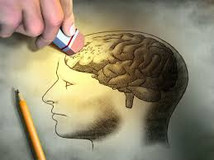


Slide 8
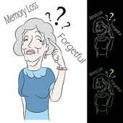
DSM-V Criteria
1. Memory impairment
2. At least one of the following:
  Aphasia
  Apraxia
  Agnosia
  Disturbance in executive functioning
3. Disturbance in 1 and 2 interferes
with daily function or independence
4. Does not occur exclusively during
delirium

Slide 9

Two types of Dementia
Cortical - Disorder affecting the cortex, the outer portion or layers of the brain.
Alzheimer’s and Creutzfeldt-Jakob are two forms of cortical dementia
Memory and language difficulties(Aphasia) most pronounced symptoms.
Aphasia is the inability to recall
words and understand common
language.

Slide 10
Two types of Dementia
Subcortical - Dysfunction in parts of the brain that are beneath the cortex.
Memory loss & language difficulties not present or less severe than cortical.
Huntington’s disease and AIDS dementia complex.
Changes in their personality and attention span.
Thinking slows down.

Slide 11
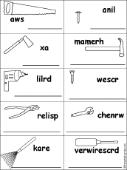
Activities of Daily Living
ADLs: bathing, toileting, transfer, dressing, eating
IADLs & Executive functioning:
  Maintaining household
  Shopping
  Transportation
  Finances

Slide 12
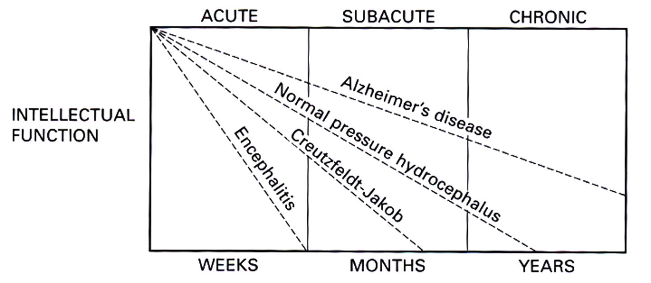
Clinical course

Slide 13
Dementia
Reversible:
  D= Drugs, Delirium
  E= Emotions (such as depression) and Endocrine Disorders
  M= Metabolic Disturbances
  E= Eye and Ear Impairments
  N= Nutritional Disorders
  T= Tumors, Toxicity, Trauma to Head
  I= Infectious Disorders
  A= Alcohol, Arteriosclerosis

Slide 14
Dementia
Irreversible:
  Alzheimer’s
  Lewy Body Dementia
  Pick’s Disease (Frontotemperal Dementia)
  Parkinson’s
  Heady Injury
  Huntington’s Disease
  Jacob-Cruzefeldt Disease

Slide 15


Slide 16
Alzheimer’s Disease
Onset usually near age 65; older age, more likely diagnosis
Absence of focal neurological signs (but significant overlap in the elderly with hx of CVAs…)
Aphasia, apraxia, agnosia
Family hx (especially for early types)
Normal/nonspecific EEG
MRI: bilateral hippocampal atrophy (suggestive)

Slide 17
Alzheimer’s Disease
Early personality changes
Loss of short term memory
Functional impairment
Visual spatial disturbances (early finding)
Apraxia
Language disturbances
Delusions/hallucinations (usually later in course)

Slide 18
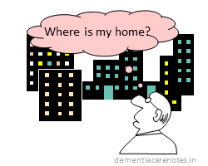
AD Early Stage
Begins with forgetfulness
Progresses to disorientation and confusion
Personality changes
Symptoms of depression/manic behaviors

Slide 19
AD Middle Stage
Need assistance with ADLs
Unable to remember names
Loss of short-term recall
May display anxious, agitated, delusional, or obsessive behavior
May be physically or verbally aggressive

Slide 20
AD Late Stage
Loss of verbal articulation
Loss of ambulation
Bowel and bladder incontinence
Extended sleep patterns
Unresponsive to most stimuli
Quadriplegia in Flexion

Slide 21
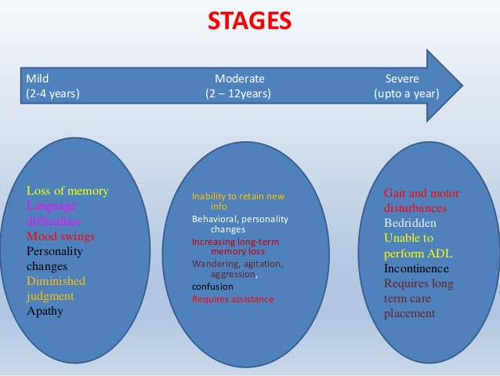

Slide 22
Alzheimer Dis.
Imaging : Ventromegally with atrophy
Pathology :
Cortical Atrophy
Senile plaques
Neurofibrillary Tangles
Biochemistry

Slide 23
Treatment
Health
Drugs :
Memantine
Donepezil
Rivastigmine
Galantamine

Slide 24
Dementia with Lewy Bodies
Cortical Lewy Bodies on pathology
10–20% of dementias
Compare to PD: Lewy Bodies in substantia nigra
Overlap with AD and PD
40% patients with AD have LBs on pathology

Slide 25
Dementia with Lewy Bodies
Visual hallucinations (early)
Parkinsonism
Cognitive fluctuations
Dysautonomia
Sleep disorders
Neuroleptic sensitivity
Memory changes later in course

Slide 26
Dementia with Lewy Bodies
Visual hallucinations
  2/3 of patients with DLB
  Rare in AD
  May precede other symptoms of DLB
  Psychosis, paranoia and other psychiatric manifestations early in course

Slide 27
Dementia with Lewy Bodies
Cognitive Fluctuations
  60–80%
  Episodic
  Loss of consciousness, staring spells, more confused or delirious like behavior
  Days of long naps
  Significant impact on functional status

Slide 28
Dementia with Lewy Bodies
Parkinsonism
  70–90%
  More bilateral and symmetric than with PD
  Tremor less common
  Bradykinesia, rigidity, gait changes

Slide 29
Dementia with Lewy Bodies
Sleep disorders
  REM sleep behavior disorder/parasomnia
  Acting out of dreams: REM dreams without usual muscle atonia
  85% of patients with DLB
  May precede other symptoms by years

Slide 30
Vascular Dementia
Onset of cognitive deficits associated with a stroke (but often no clear hx of CVA but multiple small, undiagnosed CVAs)
Abrupt onset of signs with stepwise deterioration
Findings on neurological examination
Infarcts on cerebral imaging (but ct/mri findings often have no clear relationship)

Slide 31
Overlap
Most patients previously categorized as either Alzheimer’s type or vascular type dementias probably have BOTH
Likelihood of AD and vascular disease significantly increases with age, therefore likelihood of both does as well

Slide 32
Dementia with Parkinson’s
30% with PD may develop dementia; Risk Factors:
  Age over 70
  Depression
  Confusion/psychosis on levodopa
  Facial masking upon presentation
Hallucinations and delusions
  May be exacerbated by treatment

Slide 33
Some Other Dementias

Slide 34
Progressive Supranuclear Palsy
Uncommon
Vertical supranuclear palsy with downward gaze abnormalities
Postural instability
Falls (especially with stairs)
“Surprised look”
Difficulty with spilling food/drink

Slide 35
Frontotemporal Dementia
Impairment of executive function
  Initiation
  Goal setting
  Planning
Disinhibited/inappropriate behavior (90%)
Cognitive testing may be normal; memory loss NOT prominent early feature
5–10% cases of dementia
Onset usually 45–65 (rare after age 75)
Familial: 20–40%

Slide 36
Pick’s Disease
Subtype of frontal lobe dementia
Pick bodies (silver staining intracytoplasmic inclusions in neocortex and hippocampus)
Language abnormalities and behavioral disturbances
  Logorrhea (abundant unfocused speech)
  Echolalia (spontaneous repetition of words/phrases)
  Palilalia (compulsive repetition of phrases)
  Fluent or non-fluent forms

Slide 37
Primary Progressive Aphasia
Patients slowly develop non-fluent, anomic aphasia with hesitant, effortful speech
Repetition, reading, writing also impaired; comprehension initially preserved
Slow progression, initially memory preserved but 75% eventually develop non-language deficits; most patients eventually become mute
Average age of onset = 60
Subset of FTD

Slide 38
“Reversible” Causes of Dementia
?10% of all patients with dementia; in reality, only 2–3% at most will truly have a reversible cause of dementia

Slide 39
“Modifiable” Causes of Dementia
Medications
Alcohol
Metabolic (b12, thyroid, hyponatremia, hypercalcemia, hepatic and renal dysfunction)
Depression? (likely marker though…)
CNS neoplasms, chronic subdural
NPH

Slide 40
Normal Pressure Hydrocephalus
Triad:
  Gait disturbance
  Urinary incontinence
  Cognitive dysfunction

Slide 41
NPH: Clinical Features
Gait
  Early Feature
  Most responsive to shunting
  Magnetic/gait apraxia/frontal “ataxia”
Cognitive
  Psychomotor slowing, apathy, decreased attention
Urinary
  Urgency or incontinence

Slide 42
NPH
Hydrocephalus in absence of papilledema, with normal CSF pressure
Begins as transient/intermittent increased CSF pressure, leading to ventricular enlargement; ventricular enlargement leads to normalization of CSF pressure
Thought to be due to decreased CSF absorption at arachnoid villi
Causes: SAH, tumors, CVA

Slide 43
NPH
Diagnosis: initially on neuroimaging
  Ventricular enlargement our of proportion to sulcal atrophy
Miller Fisher test: objective gait assessment before and after removal of 30 cc CSF
Radioisotope diffusion studies of CSF
MRI: turbulent flow in posterior third ventricle and within aqueduct of sylvius
MRI flow imaging
SPECT (Single Photon emission CT): decreased blood flow in frontal and periventricular areas

Slide 44
NPH : Shunting
Gait may be most responsive
Predictors of better outcome:
  Lack of significant dementia
  Known etiology (prior SAH)
  New (< 6 months) symptoms
  Prominence of gait abnormality

Slide 45
Creutzfeldt-Jacob Disease
Rapid onset and deterioration
Motor deficits
Seizures
Slowing and periodic complexes on EEG
Myotonic activity

Slide 46
MMSE
24/30 suggestive of dementia (sens 87%, spec 82%)
Not sensitive for MCI
Spuriously low in people with low educational level, low SES, poor language skills, illiteracy, impaired vision
Not sensitive in people with higher educational background

Slide 47
Other Evaluation Tools
Trails B test
  Numbers 1–25 and letters scattered across page; patient must connect, 1-A, 2-B, 3-C, etc; normally able to do in <10 minutes
  Good for patients with high function/education
Verbal Fluency Test
  Name all within category in 30 seconds – 1 minute
  Letters FAS, animals, vegetables
  Tests executive function and language, semantic memory
  Normally should name 20–30 in 60 seconds
  Highly associated with educational level
  Insight with grouping, rhyming, categories

Slide 48
Additional Evaluation
Clockface
Short assessments with good validity: 3-item recall and clockface
Neurological exam (focality, frontal release signs such as grasp, jawjerk; apraxia, cogwheeling, eye movements)
Lab testing and neuroimaging

Slide 49
Delerium
Consciousness Disorder and Dyscognition occur during a brief period.
Confusion , Irritability , Disattetion , Concentration disorder , Sleep Cycle Disorders , Fear.
Exaggeration in night.

Slide 50
Causes Of Delirium
Neurologic Dis. : Trauma , CVA , Infections , Convulsions and raised ICP.
Toxicity
Systemic Dis. : Infections , Cardiovascular, Endocrine Dis.
Hospitalization

Slide 51
Management
Delirium is a emergency.
Finding Cause
Control of Behavior
Nursing

