Slide 1
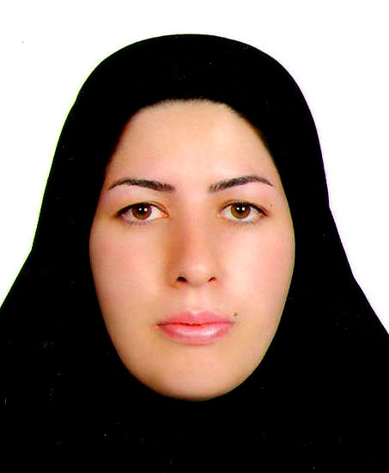
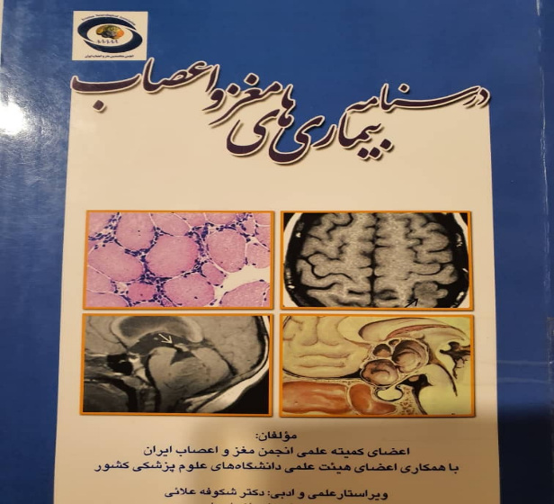

میوپاتی
دکتر مریم عابدینی

Slide 2
Definition and Classification of Myopathies
Muscle diseases constitute a variety of both acquired and hereditary disorders that can alter muscle structure, metabolism, or muscle channel function
Hereditary
  Channelopathies
  Congenital myopathies
  Metabolic myopathies Mitochondrial myopathies
  Muscular dystrophies Myotonias
Acquired
  Drug-induced myopathies
  Endocrine myopathies
  Inflammatory myopathies Myopathies associated with systemic disease
  Toxic myopathies

Slide 3
Approach to myopathy
A thorough history of the patient’s type (positive or negative) and distribution of symptoms, temporal data (progression rate, age of onset), triggering events, associated systemic signs and symptoms, past medical and family history,
Detailed neurologic examination are important to diagnose these conditions

Slide 4
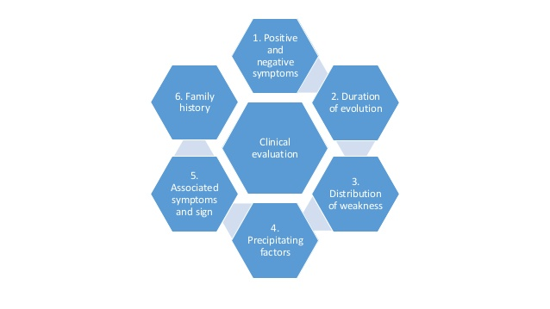
History

Slide 5
Symptoms Typically Associated With Myopathies
Negative
  Exercise intolerance
  Fatigue
  Muscle atrophy
  Weakness
Positive
  Cramps
  Contracture
  Muscle hypertrophy
  Myalgia
  Myoglobinuria
  Stiffness

Slide 6
Weakness: MOST COMMON
Proximal lower extremities:
  difficulty climbing stairs, arising from a low chair or toilet, or getting up from a squatted position.
b) Proximal upper extremities:
  trouble lifting objects over their head and brushing their hair.
c) Distal upper extremities:
  difficulty opening jars, inability to turn a key in the ignition.
d) Distal lower extremities:
  tripping due to foot-drop.
e) Cranial muscle weakness,
  dysarthria, dysphagia, or ptosis.

Slide 7
less useful negative symptom
Fatigue
Myalgia
less useful negative symptom
Nonspecific
abnormal fatigability after exercise can result from certain metabolic and mitochondrial myopathies, and it is important to define the duration and intensity of exercise that provokes the fatigue.
like fatigue, is another nonspecific symptom
episodic (metabolic myopathies)
constant (inflammatory muscle disorders)
more likely to be due to orthopedic or rheumatological disorders

Slide 8
Symptom
Muscle cramp
Muscle contractures
They are typically benign, occurring frequently in normal individuals, and are seldom a feature of a primary myopathy
Cramps can occur with:
  dehydration,
  hyponatremia,
  azotemia,
  myxedema
  disorders of the nerve or motor neuron (especially amyotrophic lateral sclerosis).
uncommon
They are typically provoked by exercise in patients with glycolytic enzyme defects.
Contractures differ from cramps in that they usually last longer and are electrically silent with needle EMG.
Cramps are characterized by rapidly firing motor unit discharge on needle EMG.

Slide 9
Myotonia
phenomenon of impaired relaxation of muscle after forceful voluntary contraction.
due to repetitive depolarization of the muscle membrane.
Patients may complain of muscle stiffness or tightness resulting in difficulty releasing their handgrip after a handshake, unscrewing a bottle top, or opening their eyelids if they forcefully shut their eyes.
Most commonly involves the hands and eyelids.
Myotonia classically improves with repeated exercise.

Slide 10
Myopathies associated with muscle stiffness
•Myotonic dystrophy
•Proximal myotonic dystrophy
•Myotonia congenita
•Paramyotonia congenita
•Hyperkalemic periodic paralysis
•Hypothyroid myopathy

Slide 11
History

Slide 12
Diagnosis of Myopathy Based on Pattern of Inheritance
X-Linked
  muscular dystrophy
  Duchenne muscular dystrophy
  Emery-Dreifuss muscular dystrophy
Autosomal Recessive
  Limb-girdle muscular dystrophy type 2
  Becker myotonia
  Metabolic myopathies
Maternal Transmission
  Mitochondrial myopathies
Autosomal Dominant
  Myotonic dystrophy
  Facioscapulohumeral muscular dystrophy
  Limb-girdle muscular dystrophy type 1
  Oculopharyngeal muscular dystrophy
  Central core myopathy
  Paramyotonia congenita
  Periodic paralysis
  Thomsen disease
  Autosomal dominant Emery-Dreifuss muscular dystrophy
  Mitochondrial myopathies

Slide 13
Drugs That Can Cause Toxic Myopathies
Inflammatory
  ◇ Cimetidine
  ◇ D-penicillamine
  ◇ Procainamide
  ◇ L-tryptophan
  ◇ L-dopa
Rhabdomyolysis and myoglobinuria
  ◇ Cholesterol-lowering drugs
  ◇ Alcohol
  ◇ Heroin
  ◇ Amphetamine
  ◇ Toluene
  ◇ Cocaine
  ◇ e-Aminocaproic acid
  ◇ Pentazocine
  ◇ Phencyclidine
Noninflammatory necrotizing or vacuolar
  ◇ Cholesterol-lowering agents
  ◇ Chloroquine
  ◇ Colchicine
  ◇ Emetine
  ◇ e-Aminocaproic acid
  ◇ Labetalol
  ◇ Cyclosporine and tacrolimus
  ◇ Isoretinoic acid (vitamin A analogue)
  ◇ Vincristine
  ◇ Alcohol
Myosin loss
  ◇ Nondepolarizing neuromuscular blocking agents
  ◇ Steroids

Slide 14
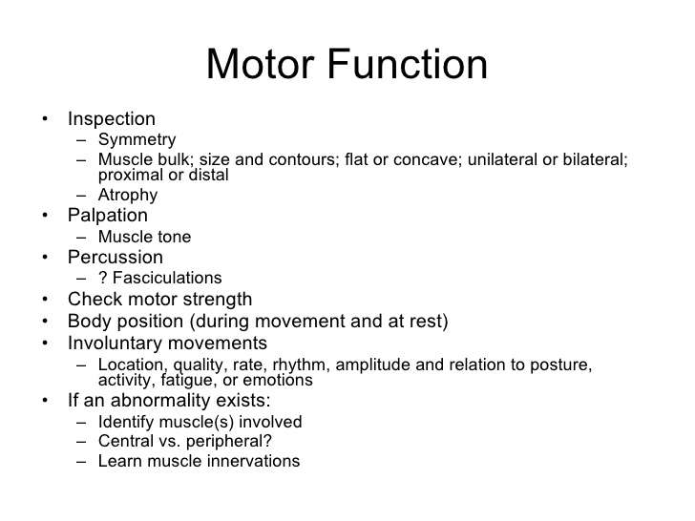
Examination

Slide 15
Examination
Muscles should be inspected for wasting or hypertrophy, not only of the extremities, but also of the head and neck.
Muscle cramping and the presence of continuous muscle activity (eg, myokymia) should be noted, and the tone and tenderness of muscles should be assessed.
Myotonia can affect proximal or distal muscles depending on the specific myopathy type, although it is typically seen in distal muscles. In myotonic disorders, direct percussion of the muscle may lead to pronounced contraction of the muscle with delayed relaxation (percussion myotonia).
Action myotonia can be assessed by having the patient sustain a grip for a brief period and then release the grip; in action myotonia, slow relaxation will be seen. Myotonia generally improves with repetition.
In contrast, paramyotonia worsens with repetitive activity. This may be demonstrated in patients with paramyotonia congenita by having them repeatedly open and close their eyelids; eventually patients will have difficulty completely opening their eyes. Both paramyotonia and myotonia worsen with cold temperature.

Slide 16
Examination
Muscle tone should be assessed as normal, decreased, or increased.
In mostmyopathies and neuromuscular junction disorders, muscle tone is usually normal or sometimes decreased.

Slide 17
Examination
For adequate examination, all patients should be asked to undress (except for undergarments) and wear a gown. Muscles should be examined in the proper
anatomic position to elicit antigravity strength or better.
The patient’s posture should be assessed while sitting, standing, and walking.
Weakness of the spine extensors may require the patient to lean forward on his or her arms or rest against the examining table to maintain an upright posture.
Neck extensor weakness may present as head drop.
Excessive lumbar lordosis, hyperextension of the knee, and ankle contractures may be seen in patients with proximal muscle weakness. An excessive lordosis is also seen with hip extensor muscle weakness.

Slide 18
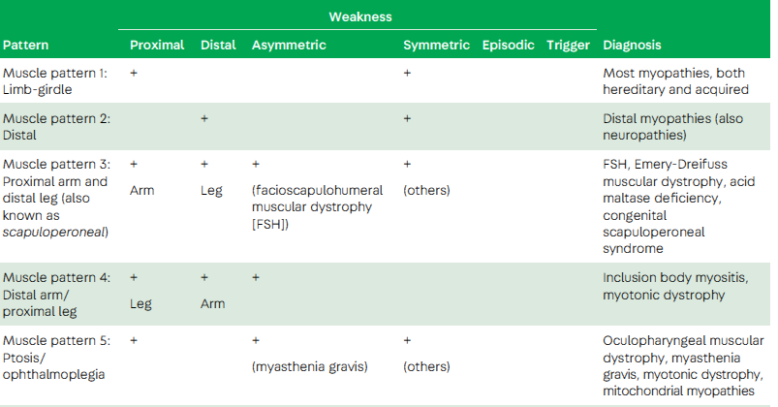
Muscle Pattern

Slide 19
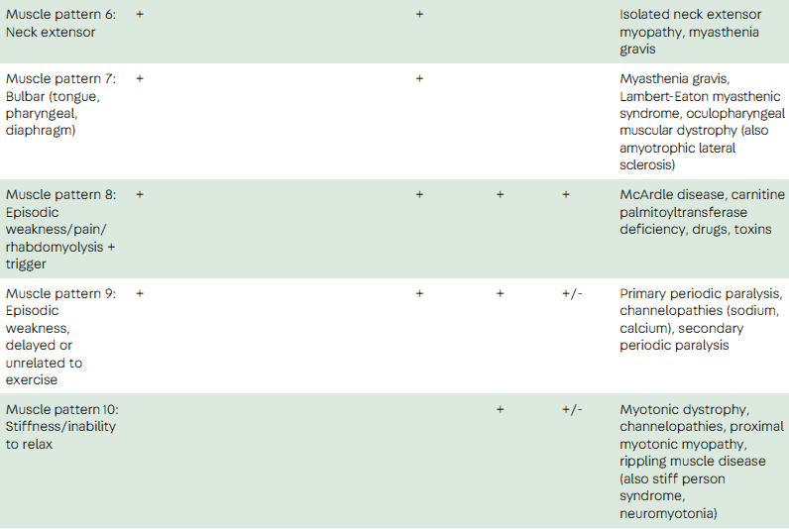
Muscle Pattern

Slide 20
Dermatomyositis (DM)-clinical
Rash
  Purplish discoloration of cheeks, eyelids: blanches (heliotrope)
  Periorbital edema
  Gottron’s papules (mimics psoriasis)
  V- sign/shawl sign
Weakness
  Symmetric weakness, proximal >distal
  Often relapse-remit
  Pain not prominent

Slide 21
Dermatomyositis (DM)-clinical
Associated cancer (10-15%)
  Breast, lung, ovarian, gastric, lymphoma
Other vascular manifestations
  Raynaud’s
  Cardiac
  Interstitial lung disease
  Smooth muscle involvement (GI)
Juvenile form
Clinically amyopathic dermatomyositis

Slide 22
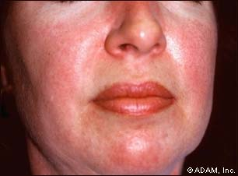
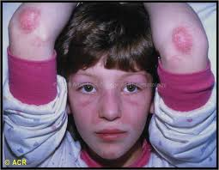
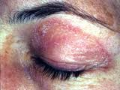
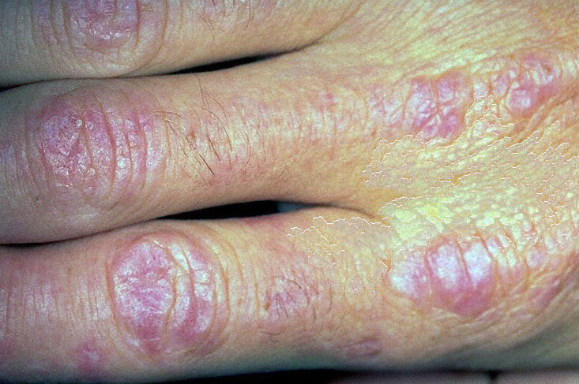
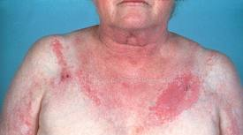
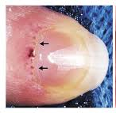
DM-rash

Slide 23
Myositis specific antibodies
Antibody | Clinical features
Antisynthetase antibodies Anti Jo-1 Anti PL-7 Anti PL-12 Anti EJ Anti OJ Anti KS Anti Zo Anti Ha | Seen in Polymyositis, Dermatomyositis and Interstitial Lung Disease
Dermatomyositis specific antibodies
Anti Mi-2 | Treatment responsive
Anti MDA5 (CADM-140) | Minimal myopathy; ILD
Anti 155/140 | Cancer associated
Anti 140 | Juvenile dermatomyositis, calcinosis
Anti SAE | Amyopathic DM
Antibodies in immune mediated necrotizing myopathy
Anti SRP | Severe, acute presentation, resistant to treatment
Anti HMGCR | Related to statin use
Adapted from: Albayda, J and Mammen, AL. Is statin-induced myositis part of the polymyositis disease spectrum? Curr Rheumatol Rep 2014;16:433.

Slide 24
DM-Pathology
  Laboratory
    CK normal or mildly elevated (aldolase)
    Antibodies
      tRNA synthetases (Jo-1 assoc w/ interstitial lung dsease)
      Anti- Mi-2 (20%)
      Other myositis specific antibodies
    May have ANA, RF positive if part of overlap syndrome
EMG: spontaneous activity, myopathic motor units

Slide 25
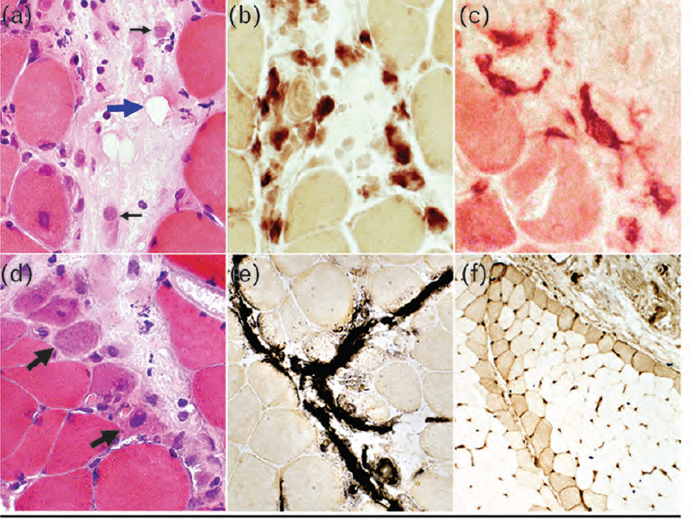
DM-Pathology
Vasculitis
  Capillaries and small blood vessels
Perivascular and perimysial inflammation
  No inflammatory cell invasion of non-necrotic fibers
  Increased expression of IFN1- inducible proteins
Humoral response
  CD4+ cells and B-cells
  Complement and immunoglobulin deposition on capillaries

Slide 26
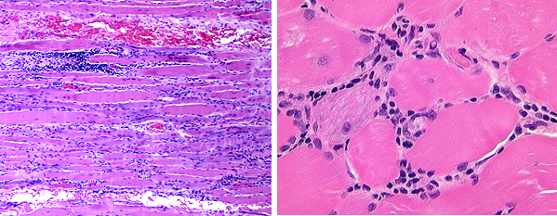
Polymyositis(Endomysial inflammation)
Exclusionary diagnosis in pts who do not have a rash or alternate muscle or nerve disease
PM is a disease of adults age between 30-60 years
More prevalent in female
Subacute to insidiously progressive, proximal arm and leg weakness
Myalgias and tenderness are common but usually not the first presenting symptoms(10-30%)
Dysphagia and dysphonia is seen in one-third of patients
Facial weakness is occasionally present and the eye muscles never get involved, except when accompanied by myasthenia gravies.
Heart muscle involvement and arrhythmic changes are also seen

Slide 27
DM and PM Treatment
Glucocorticoids
  High dose for at least 4-6wks, taper over 1yr
  80mg or 1mg/kg
  No RCTs, NIH series with 39% normalized CPK, 25% regained full strength
Immunosuppressive/steroid-sparing
  Azathioprine
    Randomized trial vs prednisone alone, better functional outcome at 3yrs
  Methotrexate (pulmonary fibrosis)
  Can be started simultaneously
Hydroxychloroquine (skin disease but not muscle)

Slide 28
Treatment resistant
Consider alternative diagnosis (IBM)
Rituximab
IVIG
Other: CSA, tacrolimus, MMF

Slide 29
Features differentiating dermatomyositis from polymyositis
Dermatomyositis Typical dermatologic manifestations May be associated with malignancy Not generally associated with systemic rheumatologic disease, except sometimes scleroderma Childhood form exists Muscle biopsy findings (perimysial and perivascular inflammation) | Polymyositis No rash unless lupus associated Not typically associated with malignancy Often associated with a systemic rheumatologic disease, including lupus, systemic sclerosis, vasculitis Adult disease Muscle biopsy findings (endomysial inflammation)

Slide 30
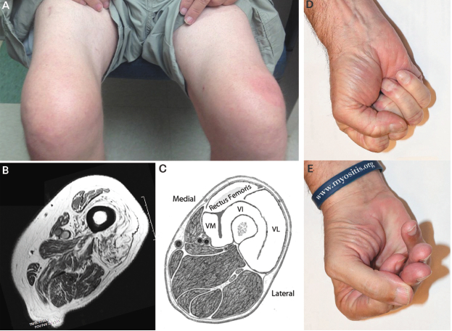
Inclusion body myositis
Most common myopathy >50yrs
Men>women
Clinical:
  Distal predominence
    FF, WF, quads, anterior tibial
    atrophy
  Asymmetrical
  1/3 with dysphagia, facial weakness

Slide 31
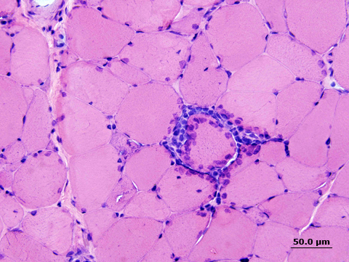
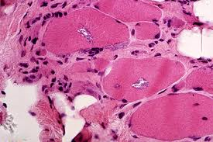
IBM-pathology
CPK may be normal or mildly elevated
EMG: myopathic, spontaneous activity, may have small and large polyphasic MUPs
Muscle biopsy
  Similar to PM
  Rimmed vacuoles (with amyloid deposits)
  EM: tubuloreticular aggregates
  Plasma cells, MHCI, CD8+
  Nondx bx in 20-30%

Slide 32
IBM treatment
Relatively resistant
Prednisone, methotrexate, azathioprine
IVIG

Slide 33
Other Immune Myopathies
Necrotizing
  Often with anti-SRP antibodies
HMGCR antibodies
U1-snRNP
Anti-MAS
Sarcoid
GVHD
Brachio-cervical inflammatory myopathy

Slide 34
Key Features of Inflammatory and Necrotizing Autoimmune Myopathies
 | Dermatomyositis | Polymyositis | Inclusion body myositis | Necrotizing autoimmune myopathy
Autoantibodies | Antisynthetase antibodies (anti-Jo-1 and others) Dermatomyositis specific antibodies (anti-Mi-2 and others) | Antisynthetase antibodies (anti-Jo-1 and others) Antibodies of systemic rheumatologic disease | Possibly anti-cytosolic 5’-nucleotidase 1A (cN1A) | Anti-SRP Anti-HMGCR
Muscle enzymes | Up to 50x ULN | Up to 50x ULN | Up to 15x ULN | Often >10x ULN
Associated disorders | Interstitial lung disease (antisynthetase) Malignancy (ovarian, lung, others) | Interstitial lung disease (antisynthetase) Systemic rheumatologic disorders | None | HMGCR – statin use
Treatment | Prednisone Azathioprine Methotrexate Rituximab IVIG Others | Prednisone Azathioprine Methotrexate Rituximab IVIG Others | None | Prednisone Rituximab

Slide 35
Endocrine myopathies
Hyperthyroidism: Proximal weakness; periodic paralysis. CPK is usually normal. Type 1 and 2 fibre atrophy
Hypothyroidism: Proximal weakness, muscle hypertrophy, cramps, myalgia. Ankle jerks may demonstrate delayed relaxation. Myoedema which is a painless mounding of the muscle when it is percussed. CPK usually elevated.
Hyperparathyroidism: Proximal weakness and atrophy
Hypoparathyroidism: mild weakness, tetany

Slide 36
Endocrine myopathy…contd
steroid myopathy: Women more prone to develop exogenous steroid induced myopathy. Usually when prednisone dosage is > 30mg/ day. Fluorinated steroids like triamcinolone> betamethasone> dexamethasone greater propensity. Proximal muscle weakness. Serum CPK , EMG is normal. Biopsy shows preferential atrophy of Type 2 fibres.
Hypocortisolism: Generalised weakness, fatigue, cramps
Diabetes when uncontrolled can produce diabetic muscle infarction especially in the thighs and can manifest as a painful swelling. CPK is normal

Slide 37
Infectious Myopathies
Bacterial
Viral
  Mild, myalgias
  Severe with rhabdo: influenza, cocksackievirus, EBV, HSV, HIV, measles, dengue
  Chronic: echovirus w/ hypogammaglobulinemia, HIV
  Pathophysiology: direct muscle invasion vs cytokine response
Parasitic

Slide 38
The Limb-Girdle Muscular
Dystrophies
Limb-girdle muscular dystrophy is defined as a genetically inherited condition primarily affecting skeletal
muscle that leads to progressive, predominantly proximal muscle weakness in individuals who have achieved independent walking and who have elevated creatine kinase levels.
Causes:
  Sarcoglycanopathies
  Calpain deficiency
  Caveolin deficiency
  Dysferlin deficiency etc.
Sarcoglycanopathies comprise about 10% of autosomal recessive limb-girdle dystrophies
  α, β, γ, δ sarcoglycans

Slide 39
Dystrophinopathies; Duchenne and Becker
Duchenne Muscular dystrophy (DMD)
X linked recessive
1:3500 male newborns
Usual onset between 3 and 5 years
Clinical features
Proximal muscles and neck flexors involved early
Calf hypertrophy, Gower’s sign
Contractures in tendoachilles, scoliosis, cardiomyopathy
Slow progression and wheelchair bound by age 12
Death common by age 20 due to respiratory cause
Lab features: CPK elevated, EMG, Biopsy
Identifiable Xp21 mutation with absence of dystrop

Slide 40
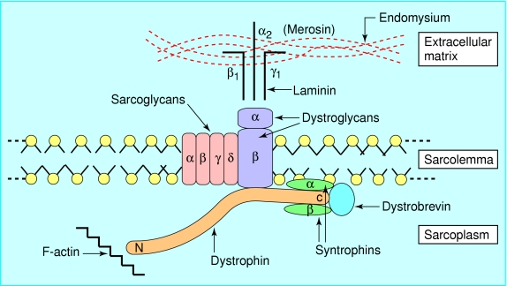
Molecular pathology
is caused by the absence or deficiency of dystrophin protein which is the product of Xp21 gene locus
It is part of the dystrophin-glycoprotein complex (DGC) which is a group of membrane-associated proteins that span the muscle sarcolemma and provide linkage and stability between the intracellular and cytoskeleton and the extracellular matrix
The postulate is that absence of this protein results in tears in the membrane due to weakening of the sarcolemma with a resulting calcium leak into the muscle fibre initiating a cascade of events leading to muscle fibre necrosis

Slide 41
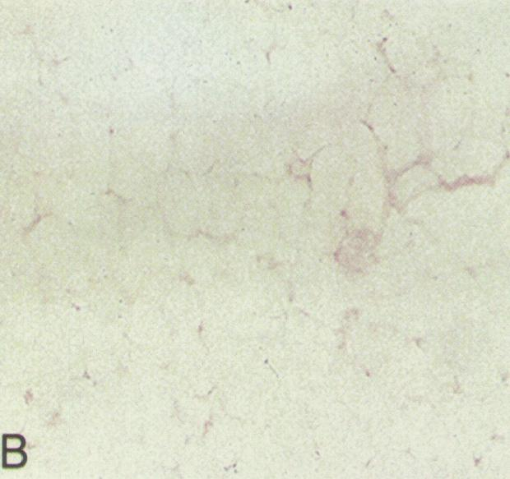
Pathology
Scattered groups of necrotic and regenerating fibres
Hypertrophied fibres
Small round fibres
Perimysial and endomysial proliferation
Muscle fibre loss and fat replacement
Dystrophin deficiency demonstrated by immunohistochemical staining

Slide 42
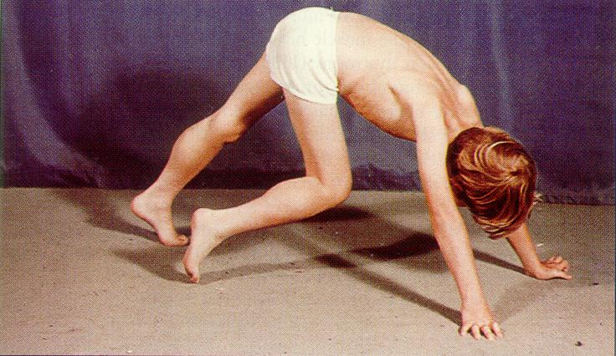
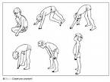
Gower’s sign

Slide 43
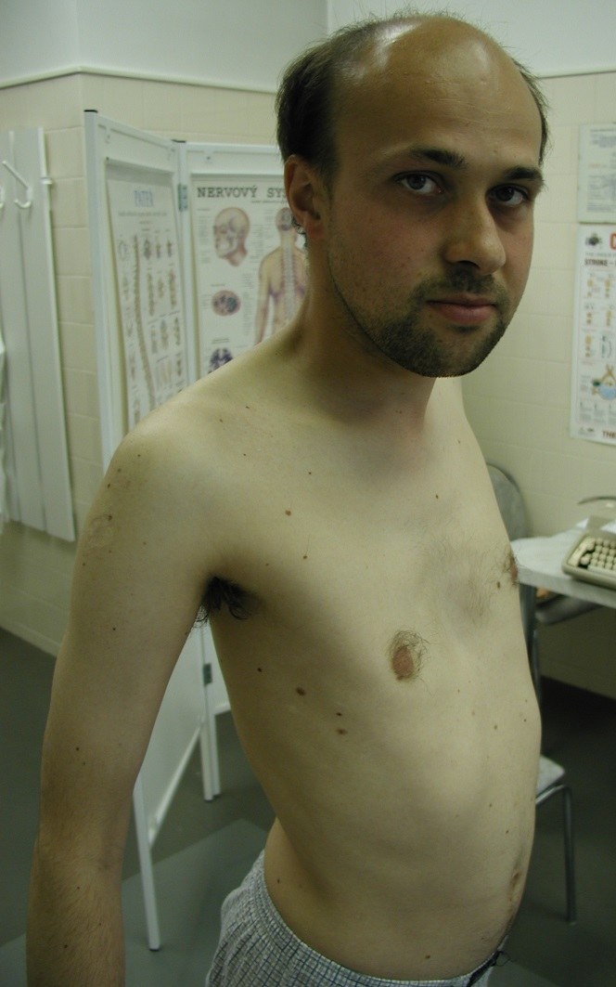
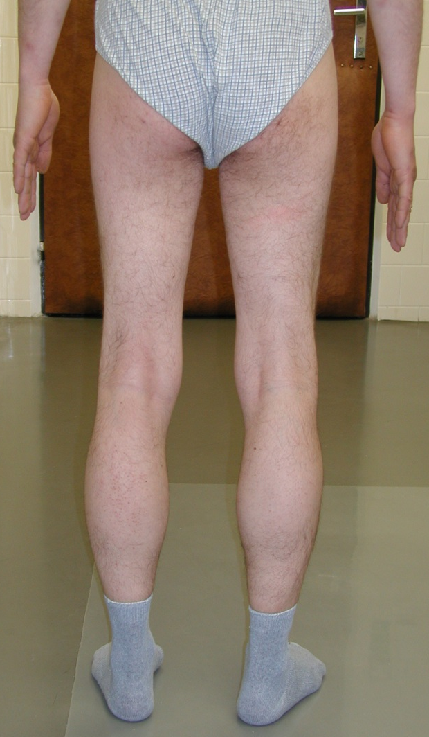
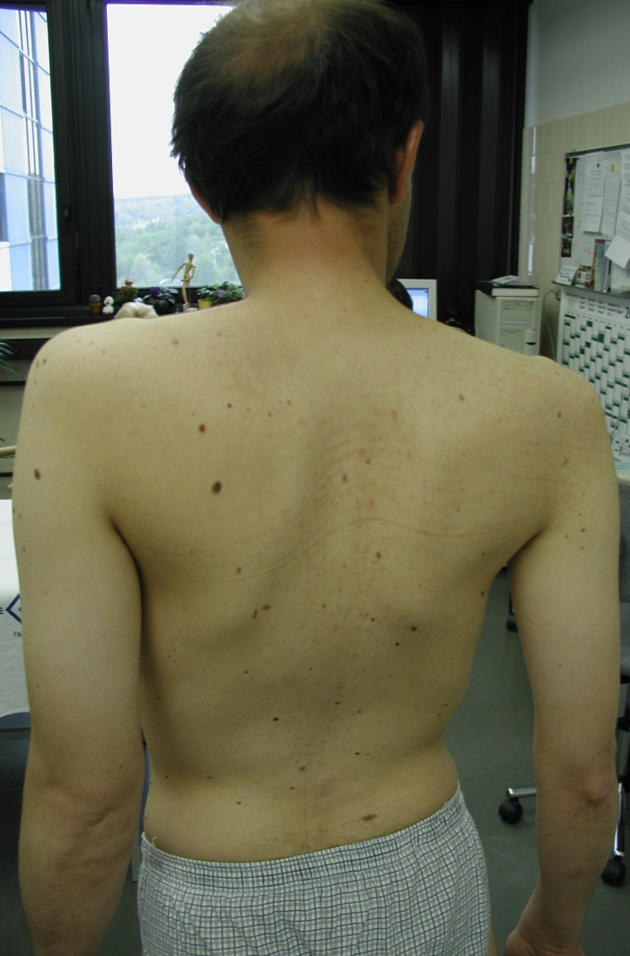
Becker

Slide 44
Facioscapulohumeral
Prevalence: 1 in 20,000
Autosomal dominant
Age of onset: infancy to middle age
Progressive muscular weakness and atrophy involving the face, scapular, proximal arm and peroneal muscles → myopathic face, winging of the scapula, inability to raise the arms, foot drop
Life span is not significantly affected

Slide 45

Facioscapulohumeral
normal deltoids
biceps, triceps commonly weak, forearm muscles are less involved resulting in a popeye-like appearance
wrist flexors stronger than wrist extensors
hip flexors and quadriceps are weaker, plantar flexors are preserved, ankle dorsiflexion is weak and foot drop may be the presenting symptom
Scapular winging may be very asymmetric (misdiagnosed as long thoracic nerve of Bell palsy)

Slide 46
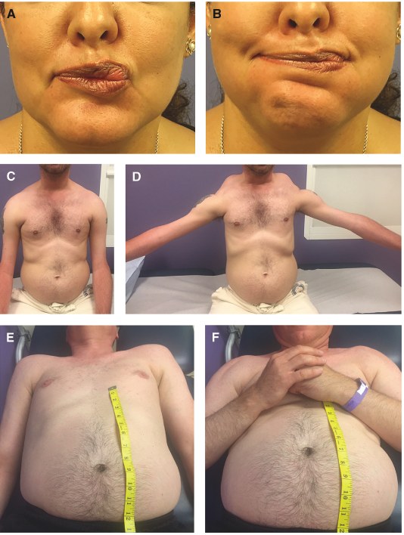
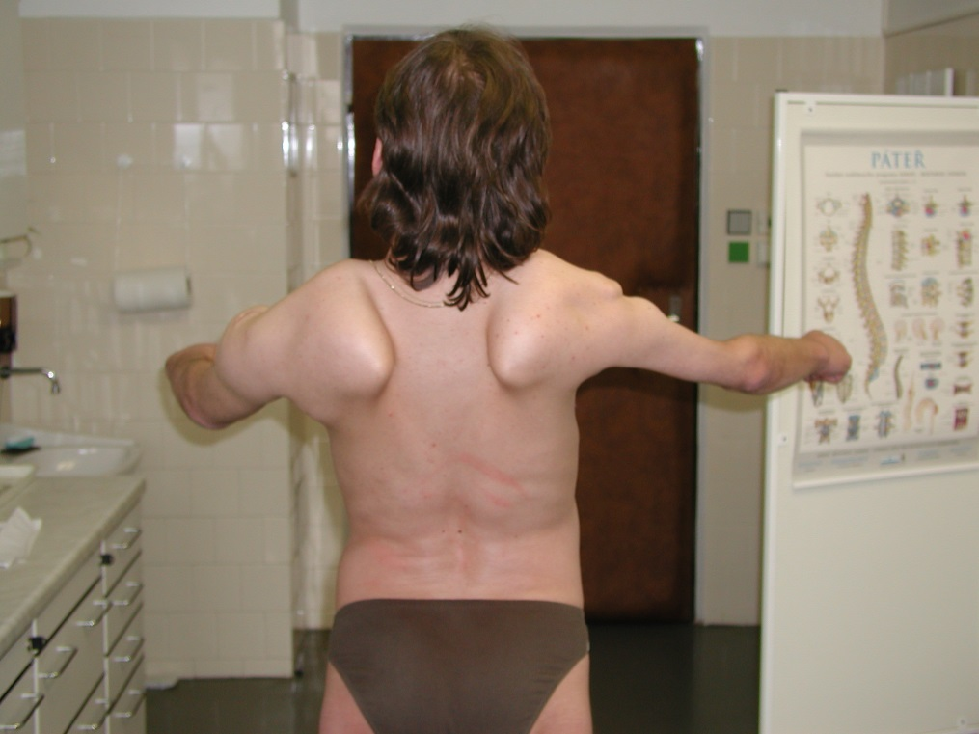
Facioscapulohumeral

Slide 47
Emery-Dreifuss muscular dystrophy
X linked
This disorder is associated with early contractures of the Achilles tendons, elbows, and spine
Humeroperoneal muscle weakness
Life threatening defects of cardiac conduction.
The protein responsible for this dystrophy (emerin) is absent in the disease and is not part of the muscle cytoskeleton, despite progressive weakness being a feature of the disease.
The protein is located on the inner surface of the nuclear membrane in skeletal and cardiac muscle.

Slide 48
Myotonic dystrophy
This is the most common inherited muscle disorder affecting adults
Autosomal dominant
15 cases per 100000 live births and M:F is 1:1
Varies from a mild late onset form of the disease to a severe congenital disorder. Severity depends on the number of CTG repeats in the DMPK gene on chromosome 19
The classical form usually present in adolescence or early adulthood
The most frequent symptoms are muscle weakness and stiffness affecting the distal limbs and myotonia

Slide 49
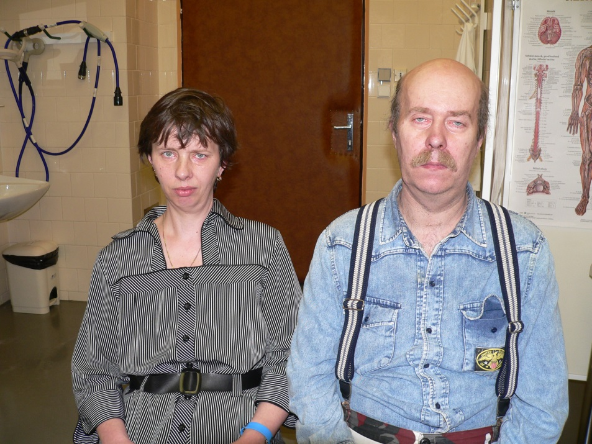
Myotonic Dystrophy
Prevalence: 1 in 8000
Cause: CTG repeat expansion in a gene on chr. 19
Autosomal dominant inheritance, with anticipation
Multisystemic disease:
  Myotonia: hyperexcitability of muscle membrane → inability of quick muscle relaxation
  Progressive muscular weakness and wasting, most prominent in cranial and distal muscles
  Cataracts, frontal balding, testicular atrophy
  Cardiac abnormalities, mental retardation

Slide 50
Myotonic Dystrophy
Systemic features
Ocular : Cataract, ptosis, retinal degeneration
Cardiac:Conduction disease, arryhtmias,cardiomyopathy
Gastrointestinal: Dysphagia, colonic dysmotility, megacolon
Endocrine: Diabetes due to insulin resistance, testicular atrophy, abnormal GH release
Immune: reduced serum immunoglobulins
Miscellaneous: Frontal balding, cranial hyperostosis

Slide 51
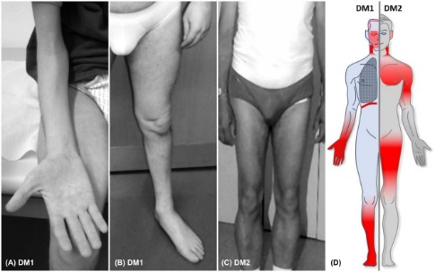
Myotonic Dystrophy
Laboratory features:
CPK mildly elevated
EMG: myotonic discharges “dive bomber”
Genetic screening: CTG repeat on chromosome 19 on leukocyte DNA
Treatment:
Supportive care
Phenytoin, procainamide and mexiletine for myotonia

Slide 52
Muscle channelopathies

Slide 53
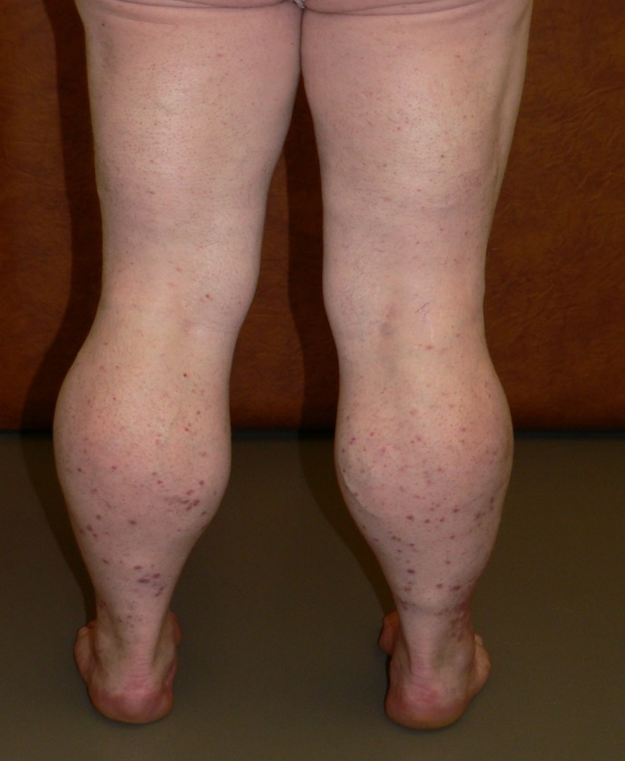
Myotonia Congenita
Mutation in the muscle Cl⁻ gene
autosomal dominant form: Thomsen autosomal recessive form: Becker
Symptoms:
  Myotonia (hyperexcitability of the muscle membrane): muscle stiffness and abnormal muscle relaxation, warm-up phenomenon
  Hypertrophied muscles
Therapy: phenytoin, mexiletin

Slide 54
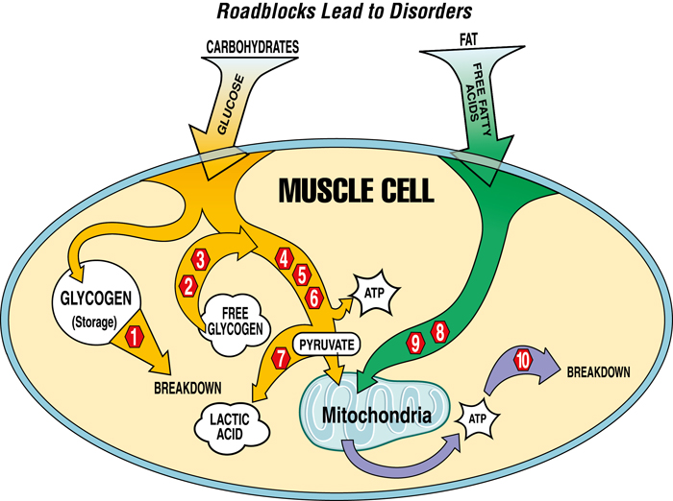
Mitochondrial and
Metabolic Myopathies
Mitochondrial, lipid, and glycogen diseases are not uncommon causes of multisystem organ dysfunction, with the neurologic features, especially myopathy, occurring as a predominant feature.
Early recognition requires basic knowledge of the varied clinical phenotypes before moving forward with a screening evaluation and possibly a genetic evaluation.
Aside from a few specific diseases for which there are recommended interventions, treatment for the majority of these disorders remains symptomatic, with clinical trials currently in progress that will hopefully result in standard treatments

Slide 55
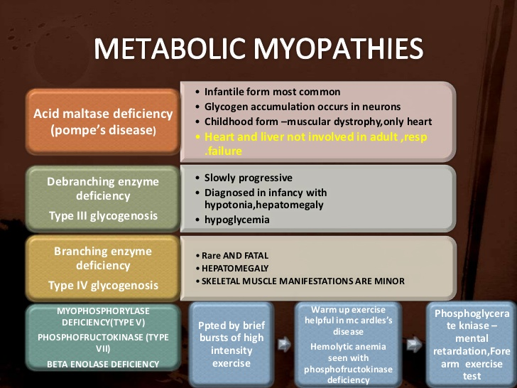

Slide 56
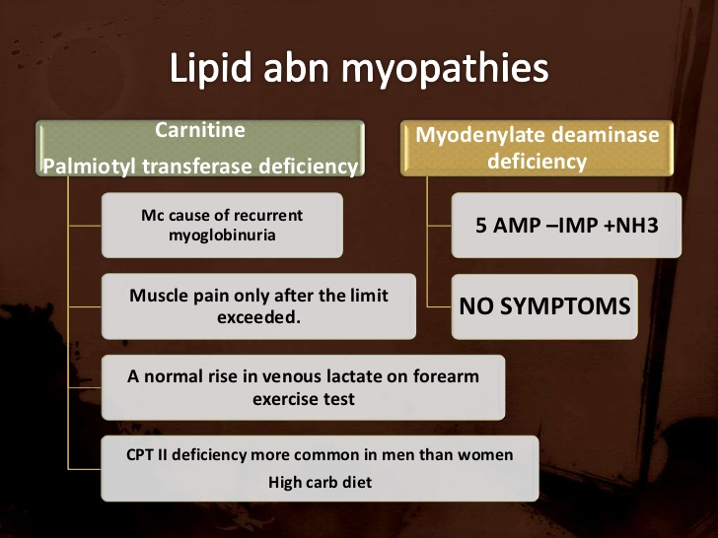

Slide 57
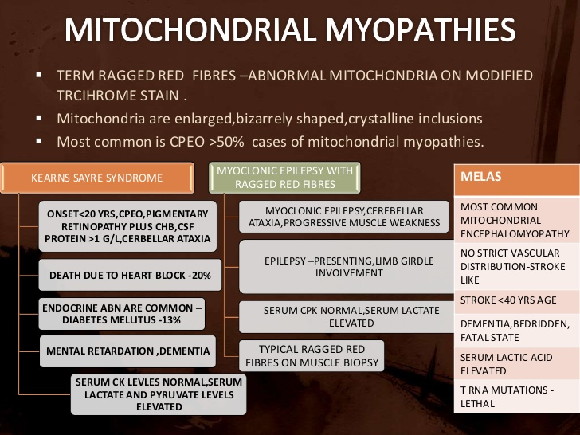

Slide 58
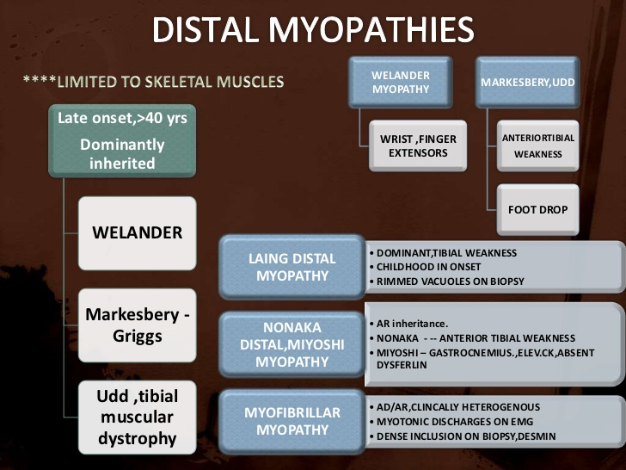

Slide 59
